Slide 1
Hackathon 2015
Submission
Team: Pretty Tough

Slide 2

Contents
1. Introduction
2. Work Flow
Data Tables
Feature Engineering
Model Training
Predictions
Streaming
3. Deployment and execution
4. Conclusion

Slide 3
Contents
1. Introduction
2. Work Flow
Data Tables
Feature Engineering
Model Training
Predictions
Streaming
3. Deployment and execution
4. Conclusion

Slide 4
Introduction
The Acquire Valued Shoppers
Consumer brands offten offer discounts to attract new shoppers to buy their products. The most valuable customers are those who return after this initial incented purchase. With enough purchase history, it is possible to predict which shoppers, when presented an offer, will buy a new item. However, identifying the shopper who will become a loyal buyer prior to the initial purchase is a more challenging task.
Pretty Tough developed a streaming machine learning application to predict which shoppers are most likely to repeat purchase on a nearly real-time basis and the algorithm and training data will be updated on real time as well.

Slide 5
Contents
1. Introduction
2. Work Flow
Data Tables
Feature Engineering
Model Training
Predictions
Streaming
3. Deployment and execution
4. Conclusion

Slide 6
Work Flow - Overall
Data Source
Feature Engineering
Model Training & Updating
Predicting by Latest Model
Output Predictions
Streaming 1: Model Training
Streaming 2: Predicting

Slide 7


Work Flow – Full Version
Database
Streaming One - Training Models
(Re-train the model every 1 hour/day)
Spark Context I/O
Memory
Spark RDD Objects
Spark RDD Transformations
Training Table
(90 new features)
Spark MLlib
New Transactions
Customer
Purchase History
Logistics Regression
Support
Vector
Machine
Table Join
Hard Drive
Transaction Table
Offers
Table
Saved LG Models
(historical models kept)
Saved SVM Models
(historical models kept)
Predictions
(historical files kept)
Campaign Strategy
Sending Offers
Table Join
Predict
Streaming Two - Predicting
(Near Real Time - every 5 s)
Memory
New Customers
Prospects
Logistics Regression
Support
Vector
Machine
Spark Context I/O
Spark MLlib
Spark RDD Objects
Spark RDD Transformations
Training Table
(90 new features)

Slide 8
Data Source
Feature Engineering
Model Training & Updating
Predicting by Latest Model
Output Predictions
Train/Test History
id - A unique id representing a customer
chain - An integer representing a store chain
offer - An id representing a certain offer
market - An id representing a geographical region
repeattrips - The number of times the customer made a repeat purchase
repeater - A boolean, equal to repeattrips > 0
offerdate - The date a customer received the offer
transactions
id - see above
chain - see above
dept - An aggregate grouping of the Category (e.g. water)
category - The product category (e.g. sparkling water)
company - An id of the company that sells the item
brand - An id of the brand to which the item belongs
date - The date of purchase
productsize - The amount of the product purchase (e.g. 16 oz of water)
productmeasure - The units of the product purchase (e.g. ounces)
purchasequantity - The number of units purchased
purchaseamount - The dollar amount of the purchase
offers
offer - see above
category - see above
quantity - The number of units one must purchase to get the discount
company - see above
offervalue - The dollar value of the offer
brand - see above

Slide 9
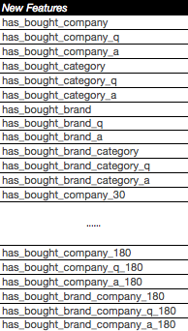
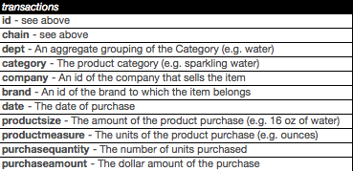
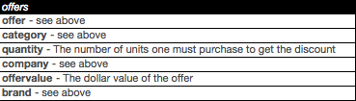
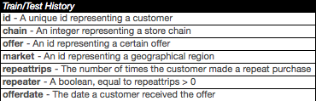
Data Source
Feature Engineering
Model Training & Updating
Predicting by Latest Model
Output Predictions
Reform
80% Split Training
20% Split Validation
Reform
Testing dataset
Reform

Slide 10
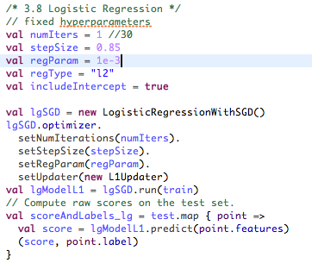
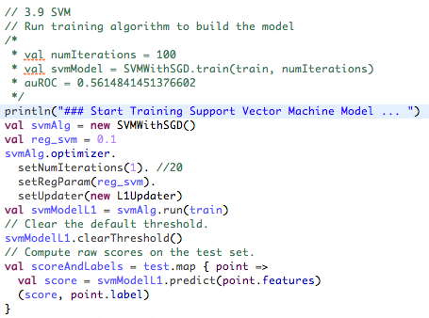
Data Source
Feature Engineering
Model Training & Updating
Predicting by Latest Model
Output Predictions
Logistics Regression:
Support Vector Machine:

Slide 11
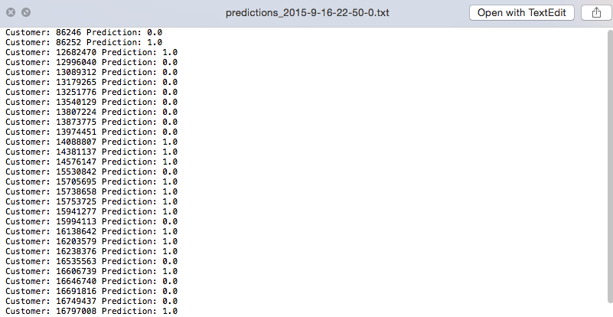
Data Source
Feature Engineering
Model Training & Updating
Predicting by Latest Model
Output Predictions
Prediction: 1 (customer will repeated purchase offer)
0 (customer will not repeated purchase offer)
New customers will be predicted every selected time interval

Slide 12
Contents
1. Introduction
2. Work Flow
Data Tables
Feature Engineering
Model Training
Predictions
Streaming
3. Deployment and execution
4. Conclusion

Slide 13
Project Structure and Files
Root Folder | Level 1 | Level 2 | Level 3 | Descriptions
Spark_Hackathon | build.sbt |  |  | SBT Config File
 | data | offers |  | contains information about the offers
 |  | testHistory |  | contains the incentive offered to each customer but does not include their response
 |  | trainHistory |  | contains the incentive offered to each customer and information about the behavioral response to the offer
 |  | transactions_sample |  | ontains transaction history for all customers
 | models | logistic |  | logistic regression models (file name format: lgModel_YYYY-MM-DD)
 |  | predictions | predictions_2015-9-19-9-28-46.txt | prediction outputs (file name format: predictions_YYYY-MM-DD-HH-MM-SS)
 |  | svm |  | Null
 | src/main/scala | StreamingMachineLearning_Main.scala |  | main class of application
 |  | subSampling.scala |  | script to sample the whole transaction table (1% sample rate)
 |  | utilClasses | modelPredict.scala | function to predict the new coming customers
 |  |  | modelTraining.scala | function to re train the model
 |  |  | utility.scala | other functions

Slide 14
Deployment and Execution
Commands
1. cd spark/spark_hackathon
2. sbt
[info] Loading global plugins from /Users/ivanliu/.sbt/0.13/plugins
[info] Loading project definition from /Users/ivanliu/Spark/Spark_Hackathon/project
[info] Set current project to Spark_Hackathon (in build file:/Users/ivanliu/Spark/Spark_Hackathon/)
3. ~run-main utilClasses.StreamingMachineLearning_Main "data/trainHistory" "data/testHistory" 30 22
Parameters: StreamingLogisticRegression <trainingDir> <testDir> <BatchDuration> <trainHour>
<trainingDir>: path of training datasets
<testingDir>: path of testing datasets
<BatchDuration>: x seconds of streaming interval
<trainHour>: hour in a day that you want to retrain your model. (0-23)

Slide 15
Contents
1. Introduction
2. Work Flow
Data Tables
Feature Engineering
Model Training
Predictions
Streaming
3. Deployment and execution
4. Conclusion

Slide 16
Conclusion
In this case, we performed analysis on transactions data firstly to get business insights. We generated 90 new features based on existing transaction data to translate and understand our customers behaviors. And because of the capabilities of Spark and Big Data, these analysis and insights will be continuosely evolving on a real time basis.
In turn, we can take advantages of those insights and analysis to make predictions to identify the most valuable potential customers or build a acquisitions pool so that we can launch campaigns or offers more precisely.
The idea and application from our perspective is promising and definitely valuable to improve ROI and offer response in this case.

Slide 17
Thank You!
18 September 2015

